Slide 1
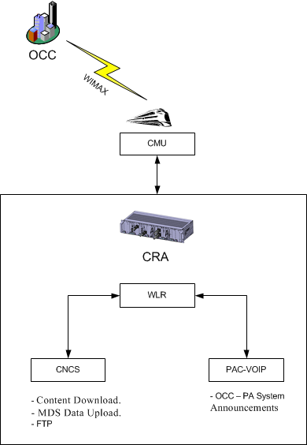
- Allocate 2 fixed IP
CNCS downloads contents and uploads the MDS data by using the FTP method.
PAC-VOIP card transmits voice data by using the OCC-SIP Protocol.

